Slide 1
Heterogeneous Graph Neural Networks for Extractive Document Summarization
Yizhu Liu
2021/4/28
Notes:
published by ACL 2020

Slide 2
Outlines
Background: Extractive Summarization
Motivation
Approach
Experiment
Conclusion
Notes:
introduce this paper according to these 5 aspects

Slide 3
Background: Extractive Summarization
Extractive Summarization
justin timberlake and jessica biel , the celebrity couple announced the arrival of their son , silas randall timberlake , in statements to people . “ silas was the middle name of timberlake ’s maternal grandfather bill bomar , who died in 2012 , while randall is the musician ‘ own middle name , as well as his father ‘s first , " people reports . the couple announced the pregnancy in january , with an instagram post . it is the first baby for both .
Source Document
the celebrity couple announced the arrival of their son , silas randall timberlake .
it is the first baby for both .
Summary
Notes:
Extractive summarization aims to extract important and relevant sentences from the original documents and reorganize them as a summary.
In this example, the two sentences in summary is selected from the source document.

Slide 4
Background: Extractive Summarization
Encoder
Decoder
Notes:
As we known, the encoder-decoder model has been widely used in summarization.

Slide 5
Background: Extractive Summarization
Encoder
Sequence of words
Encoder
w₁
w₂
w₃
w₄
Decoder
Notes:
For Encoder, previously, we take the tokens of document as input of the encoder,
ignore the relation among sentences

Slide 6
Background: Extractive Summarization
Document Encoder
Encoder
Sentence encoder
Document Encoder
CNN
LSTM
Transformer
Sentence Encoder
Sentence Encoder
w₁
w₂
w₃
w₄
Decoder
Auto-regressive
Pointer Network
Non Auto-regressive
Sequence Labeling
Notes:
For learning the relation of cross-sentences, most existing models start to use Hierarchical encoder
CNN -> sentence encoder, LSTM -> document encoder
Transformer-> sentence/document encoder
Decoder

Slide 7
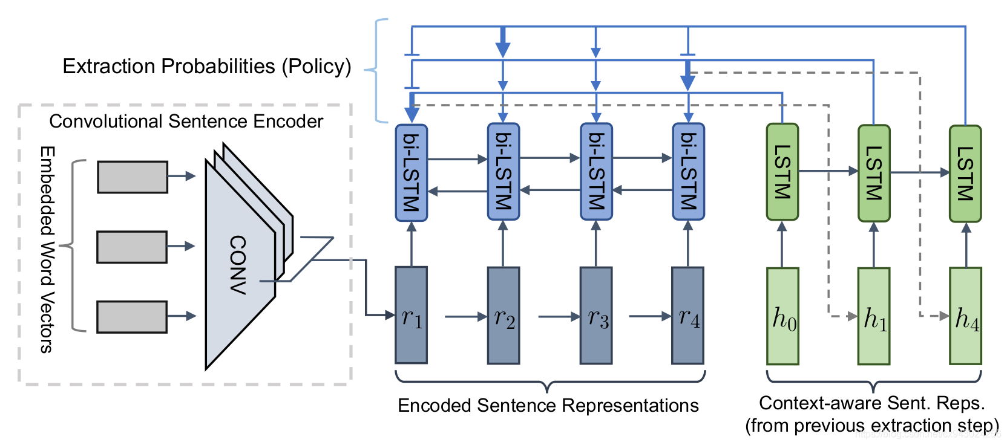
Background: Extractive Summarization
Encoder
Sentence encoder
Document Encoder
CNN
LSTM
Transformer
Decoder
Auto-regressive
Pointer Network
Non Auto-regressive
Sequence Labeling
Notes:
the sentence selection at current step is depend on the previously selected sentences.
in this example, h1 is the output of first step and the input of second step

Slide 8
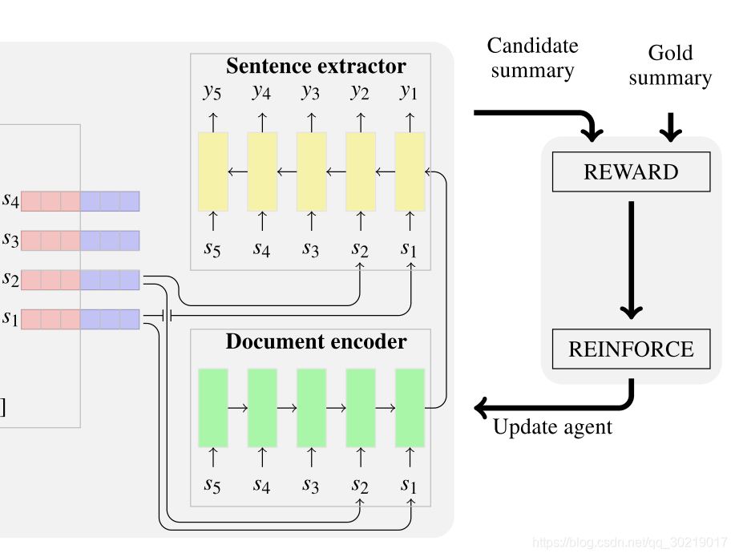
Background: Extractive Summarization
Encoder
Sentence encoder
Document Encoder
CNN
LSTM
Transformer
Sentence encoder
Decoder
Auto-regressive
Pointer Network
Non Auto-regressive
Sequence Labeling
Notes:
during decoding, at each step, the sentence extractor do the classification and judge whether the sentence should be selected
The sentence selection at each step is independent and has no relationship with other selected sentences

Slide 9
Background: Extractive Summarization
Encoder
Sentence encoder
Document Encoder
CNN
LSTM
Transformer
Supervised Learning
Reinforcement Learning
Learning
Schema
Pointer Network
Sequence Labeling
Decoder
CNN
LSTM
Transformer
Decoder
Auto-regressive
Pointer Network
Non Auto-regressive
Sequence Labeling
Encoder
GloVe
BERT
Newsroom
External
Knowledge
Word2vec
Internal

Slide 10
Background: Extractive Summarization
Encoder
Sentence encoder
Document Encoder
CNN
LSTM
Transformer
Supervised Learning
Reinforcement Learning
Learning
Schema
Pointer Network
Sequence Labeling
Decoder
CNN
LSTM
Transformer
Decoder
Auto-regressive
Pointer Network
Non Auto-regressive
Sequence Labeling
Encoder
GloVe
BERT
External
Knowledge
Word2vec
Internal
Notes:
In general, extractive summarization consists of these four parts
import external knowledge

Slide 11
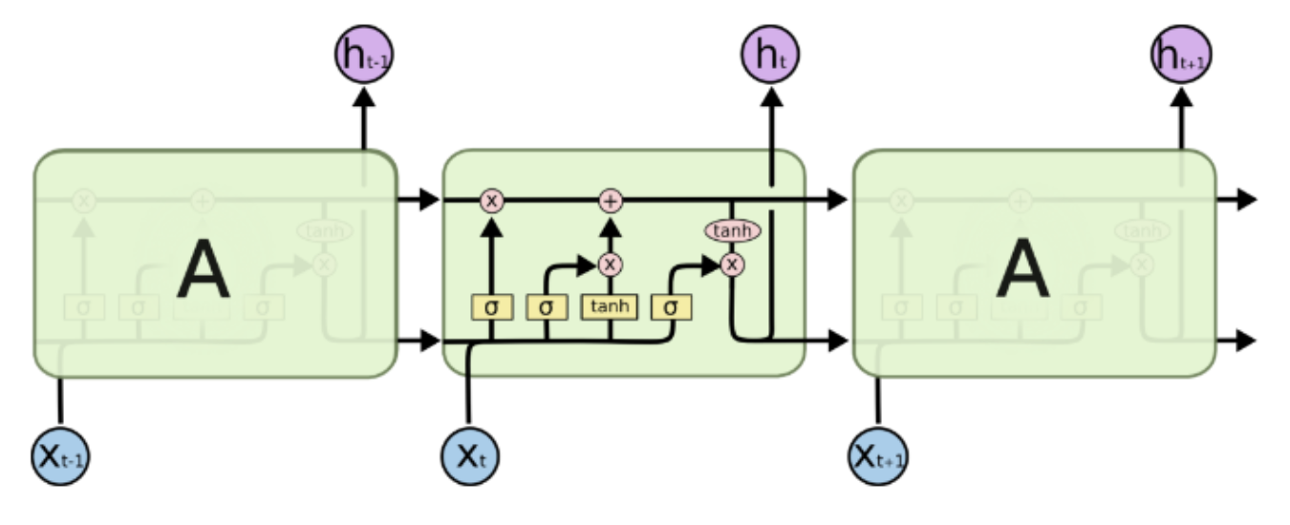
Background: Extractive Summarization
Encoder
LSTM is more likely to suffer from architecture overfitting, while Transformer is more robust.
forget gate
Notes:
LSTM is good at discovering the relation of long dependences.
forget gate decides what information is retained and what information is discarded
The relation always matches the LSTM structure, but at the same time, LSTM also loss some information that does not match its structure.
Transformer using self-attention is full-connected, which can capture the relation between words or sentences that are farther away

Slide 12
Background: Extractive Summarization
Encoder
LSTM is more likely to suffer from architecture overfitting, while Transformer is more robust.
Position embedding or sentence embedding
Quiz: Which is important?
Position embedding
Notes:
input is the combination of position and sentence embedding
Position embedding is more important than sentence embedding
only using position embedding as input is better than only using sentence embedding as input
In the real world, we select a sentence for summary according to its semantic information.
So, the test shows that the sentence embedding is not good enough or the model cannot capture the semantic information of sentences through sentence embedding

Slide 13
Background: Extractive Summarization
Encoder
LSTM is more likely to suffer from architecture overfitting, while Transformer is more robust.
Position embedding or sentence embedding
Decoder
Pointer Network and Sequence Labeling
Notes:
use PTR or SeqLab for decoder
which is better?

Slide 14
Background: Extractive Summarization
Encoder
LSTM is more likely to suffer from architecture overfitting, while Transformer is more robust.
Position embedding or sentence embedding
Decoder
Pointer Network and Sequence Labeling
Notes:
Pointer is better than Sequence labeling
Why? the output of pointer network need consider the previous output information

Slide 15
Background: Extractive Summarization
Sentence-level
Transformer is more robust than LSTM
Graph architecture
Position embedding is important than sentence embedding.
Better way to encode the content
HeterSummGraph
Notes:
Transformer can be seen as a fully-connected graph
If there is a special graph that is more effective than transformer
As position embedding… is unreasonable
We want to find a better way to encode the content

Slide 16
Motivation
How to model cross-sentence relationship?
Graph
Similarity-based connectivity
Discourse connectivity
Full-connected (Transformer)
Threshold
Error Propagation
Lack Prior
Notes:
The most important thing for Extractive summarization is to model cross…
Early traditional work use inter-sentence cosine similarity to build the graph
rank sentences by LexRank and TextRank.
Recently, some works account for discourse inter-sentential relationships when building summarization graphs.
However, they usually rely on external tools and need to take account of the error propagation problem.
A more straightforward way is to create a sentence-level fully-connected graph, such as transformer encoder.
Transformer learns the pairwise interaction between sentences.
Despite their success, There are problems of training time and space

Slide 17
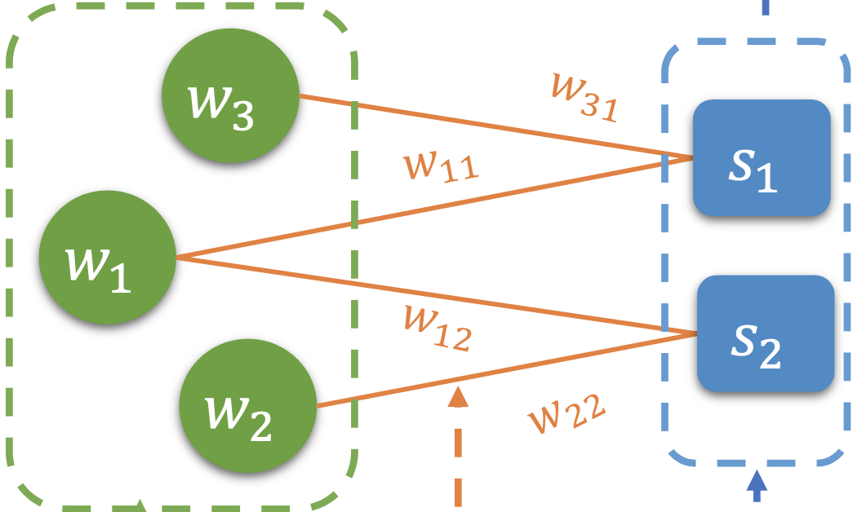
Approach—Heterogeneous Graph
How to model cross-sentence relationship?
Word
Sentence

Slide 18
Approach—Heterogeneous Graph
Heterogeneous Summarization Graph
Graph initializers
word node
sentence node
edge feature
Heterogeneous graph layer
word → sentence
sentence → word
Sentence selector
Notes:
In this paper, they want to construct an more effective graph structure for summarization， hetero…
consists of three part

Slide 19
Approach—Heterogeneous Graph
Heterogeneous Summarization Graph
Graph initializers
word node
sentence node
edge feature
Heterogeneous graph layer
word → sentence
sentence → word
Sentence selector
Word
Sentence
Notes:
consists of two types of nodes: word nodes and sentences nodes
Each sentence nodes connects with word nodes contained in it and takes the importance of the relation as their edge feature.
Thus, relationships between sentence nodes are enriched via word nodes.

Slide 20
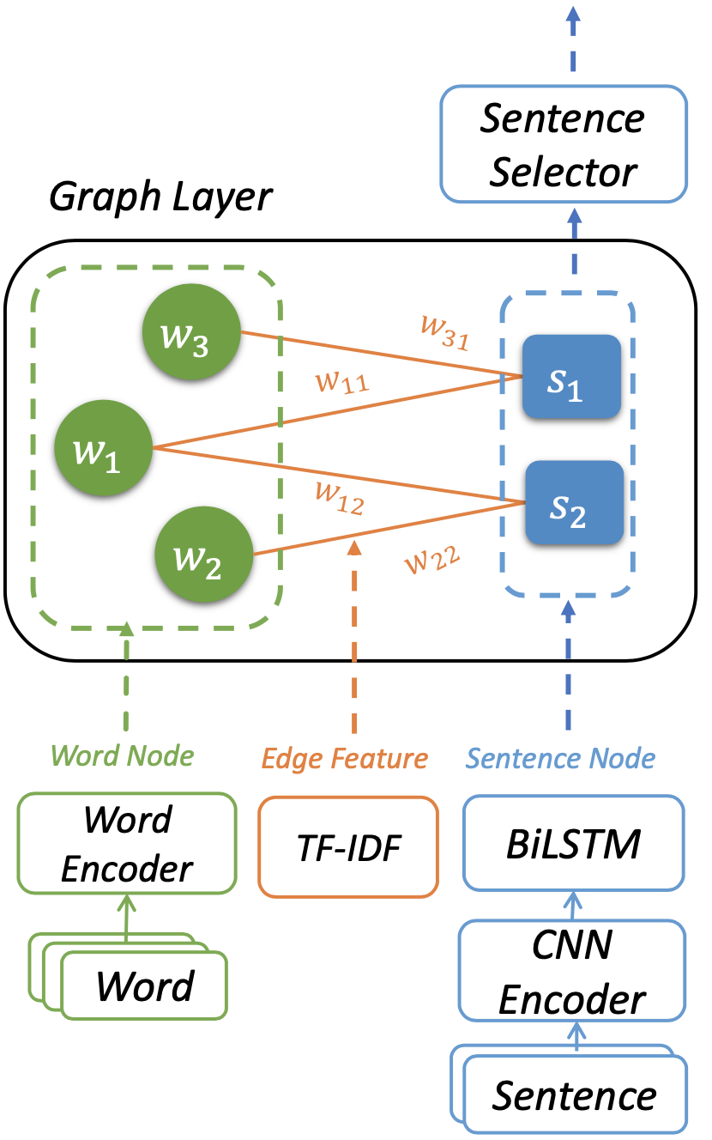
Approach—Graph Initializers
Heterogeneous Summarization Graph
Graph initializers
word node
sentence node
edge feature
Heterogeneous graph layer
word → sentence
sentence → word
Sentence selector

Slide 21
Approach—Graph Initializers
Heterogeneous Summarization Graph
Graph initializers
word node
sentence node
edge feature
Heterogeneous graph layer
word → sentence
sentence → word
Sentence selector

Slide 22
Approach—Graph Initializers
Heterogeneous Summarization Graph
Graph initializers
word node
sentence node
edge feature
Heterogeneous graph layer
word → sentence
sentence → word
Sentence selector

Slide 23
Approach—Graph Initializers
Heterogeneous Summarization Graph
Graph initializers
word node
sentence node
edge feature
Heterogeneous graph layer
word → sentence
sentence → word
Sentence selector

Slide 24
Approach—Heterogeneous graph layer
Heterogeneous Summarization Graph
Graph initializers
word node
sentence node
edge feature
Heterogeneous graph layer
word → sentence
sentence → word
Sentence selector

Slide 25
Approach—Heterogeneous graph layer
Graph Attention
h_{i}
w₁
w₃
s₁
w₁₁
w₁
h_{j}
s₁
ReLU
a_{ij}
s₂
w₂

Slide 26
Approach—Heterogeneous graph layer
Graph Attention
h_{i}
w₁
w₃
s₁
w₁₁
w₁
h_{j}
s₁
ReLU
a_{ij}
s₂
w₂
e_{ij}
w₁₁

Slide 27




Approach—Heterogeneous graph layer
h₂
a₁₁
a₁₂
avg($Σa_{ij}h_{i})$
w₁
h₃
h₁
$$h_{1}^{′}$$
w₃
a₁₅
a₁₃
s₁
a₁₄
h₅
w₁₁
h₄
w₁
s₂
h₁
a₁₁
w₂
a₁₂
avg($Σa_{ij}h_{i})$
s₁
h₂
h₄
$$h_{1}^{′}$$
a₁₃
a₁₅
a₁₄
h₅
h₃

Slide 28
Approach—Heterogeneous Graph Layer
Update Mechanism
w₃
w₃
s₁
s₁
w₁
w₁
s₂
s₂
w₂
w₂
Update S₁
Update W₁

Slide 29
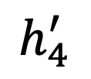
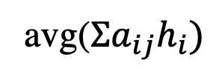
Approach—Heterogeneous Graph Layer
Update Mechanism
w₃
s₁
avg($Σa_{ij}h_{i})$
h₁
h₄
$$h_{4}^{′}$$
w₁
a₄₁
s₂
a₃₁
w₂
h₃
Update S₁

Slide 30
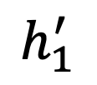
Approach—Heterogeneous Graph Layer
Update Mechanism
w₃
w₃
s₁
s₁
avg($Σa_{ij}h_{i})$
h₄
h₁
$$h_{1}^{′}$$
w₁
w₁
a₁₄
s₂
s₂
a₁₅
w₂
h₅
w₂
Update W₁

Slide 31





Approach—Heterogeneous Graph Layer
Transformer
$$h_{1}^{′}$$
$$h_{2}^{′}$$
$$h_{3}^{′}$$
$$h_{4}^{′}$$
$$h_{5}^{′}$$
Notes:
Heterogeneous Graph consists of a graph attention and two layer transformer attention
capturing the relation between word and sentence and the relation between sentences

Slide 32





Approach—Heterogeneous Graph Layer
Transformer
Heterogeneous Summarization Graph
Graph initializers
word node
sentence node
edge feature
Heterogeneous graph layer
word → sentence
sentence → word
Sentence selector
$$h_{1}^{′}$$
$$h_{2}^{′}$$
$$h_{3}^{′}$$
$$h_{4}^{′}$$
$$h_{5}^{′}$$
Notes:
the architecture are changed as this

Slide 33
Approach—Sentence Selector
Transformer
Heterogeneous Summarization Graph
Graph initializers
word node
sentence node
edge feature
Heterogeneous graph layer
word → sentence
sentence → word
Sentence selector
$$h_{1}^{′}$$
$$h_{2}^{′}$$
$$h_{3}^{′}$$
$$h_{4}^{′}$$
$$h_{5}^{′}$$

Slide 34
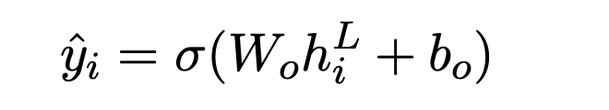
Approach—Sentence Selector
Node classification for sentences
Trigram Blocking
avoid repetitive sentence
Notes:
Specifically, we rank sentences by their scores and discard those which have trigram overlappings with their predecessors.

Slide 35
Approach
How to model cross document relationship?
Quiz

Slide 36
Approach
How to model cross document relationship?
s₁₁
w₁
s₁₂
D₁
w₂
w₃
s₂₁
D₂
w₄
s₂₂

Slide 37
Experiment
Datasets
CNN/Daily Mail
- 287,227/13,368/11,490
NYT50
- 100,834/4,000/3,452
Multi-News
44,972/5,622/5,622
Each example consists of 2-10 source documents and a human-written summary.

Slide 38
Experiment
Models for comparison
Ext-BiLSTM
Regarding a document as a sequence of sentences.
Classification: sentence nodes
CNN encoder for the word level and 2-layer BiLSTM for sentence level
Ext-Transformer
- Transformer encoder
HeterSUMGraph (HSG)
Notes:
directly take out the initialization of sentence nodes for classification

Slide 39
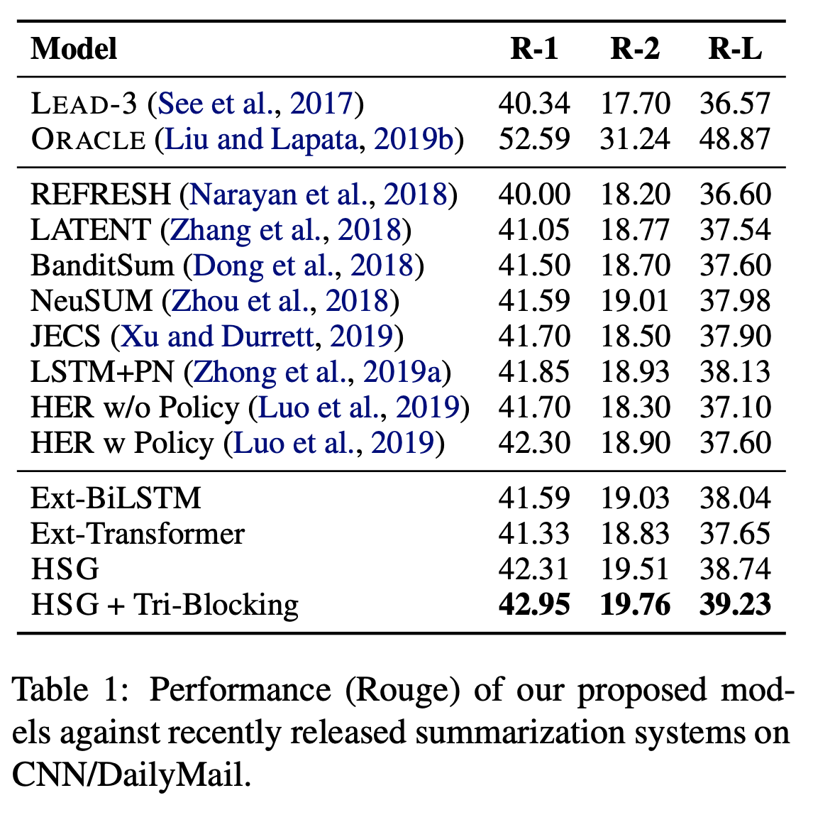
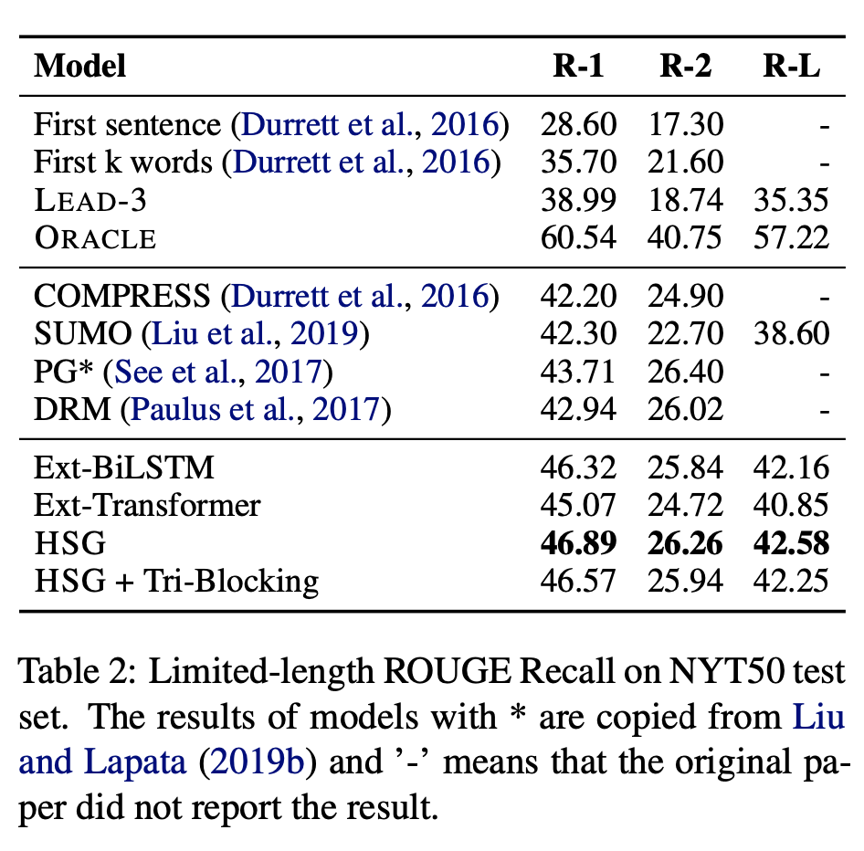
Experiment—Single-Document
Notes:
ORACLE is the upper boundThe algorithm generates an oracle consisting of multiple sentences which maximize the ROUGE-2 score against the gold summary.

Slide 40
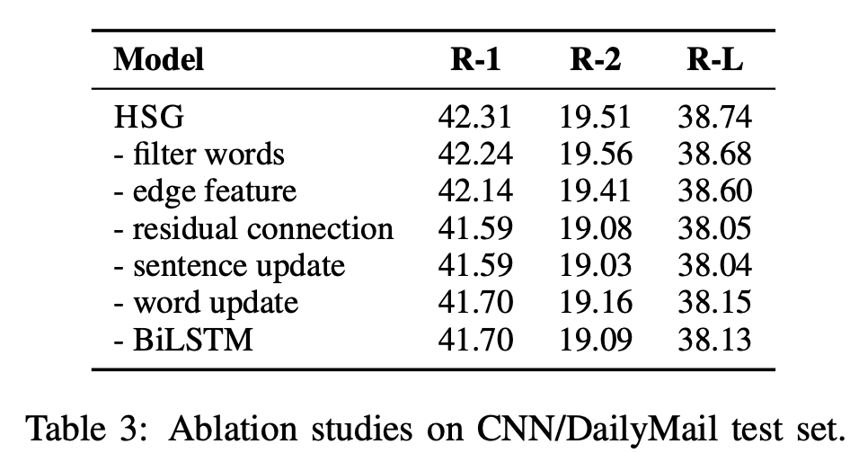
Experiment—Single-Document

Slide 41
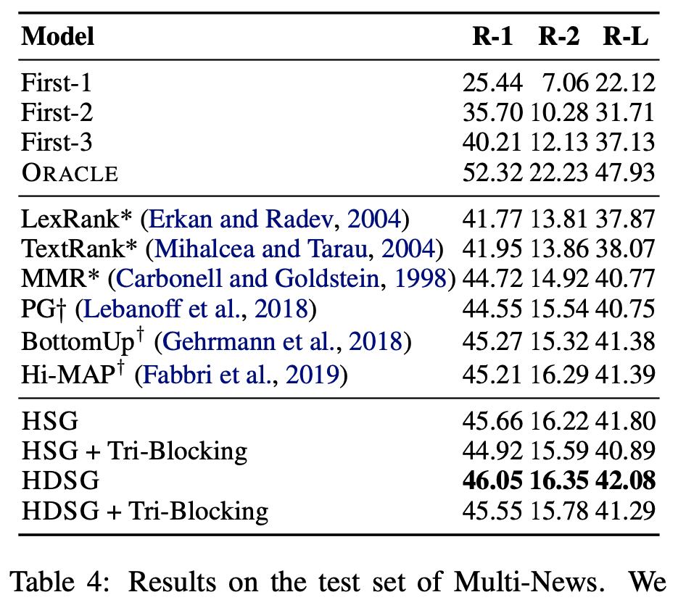
Experiment—Multi-Document
Notes:
used for single document summarization
the results is similar

Slide 42
Experiment—Multi-Document
Notes:
more effective on Abstractive summarization
After add document nodes
There are some problems in their experiments,
they didn’t use the extractive summarization dataset for testing.
They didn’t compare their approach with pretrained model.
We may wonder if their approach is effective with BERT encoder as word encoder or sentence encoder

Slide 43
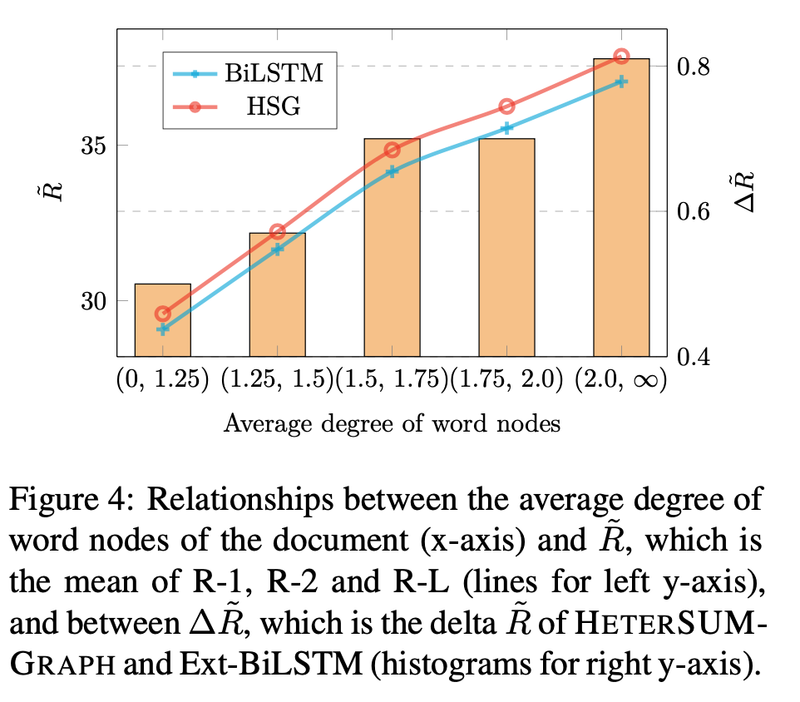
Experiment

Slide 44
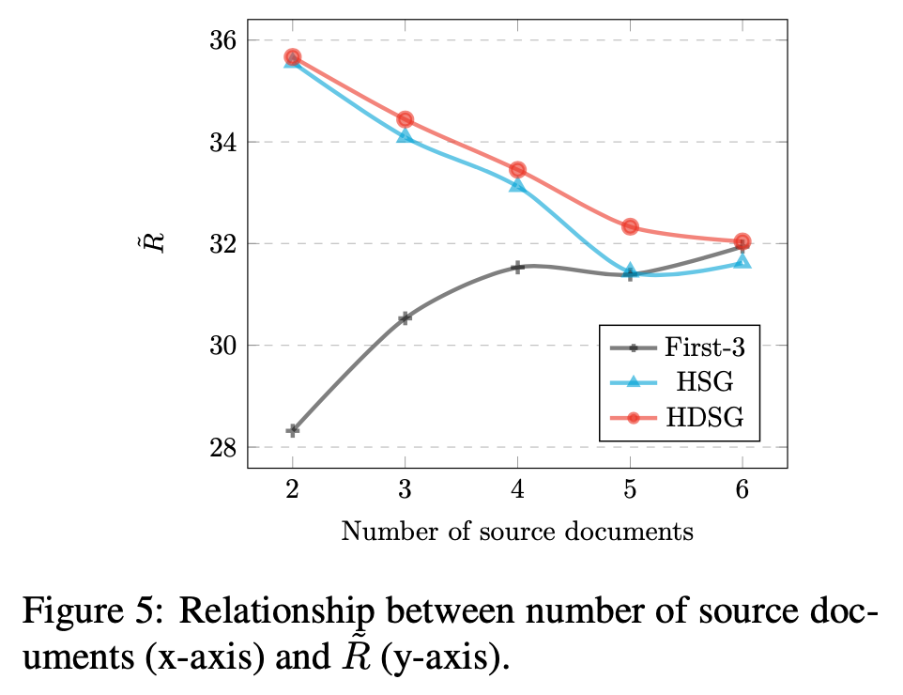
Experiment

Slide 45
Conclusion
Graph is helpful!
Cross-sentence relations
Single-Document Summarization and Multi-Document Summarization
The nodes in different types of the graph.
It can be used in Abstractive Summarization.
Notes:
The nodes in different types of the graph can enhance the relation of sentences

